Slide 1





















































Dr. HAFIZUR RAHMAN - B.E., M.Tech., h.D. ASSISTANT ROFESSOR
B.GOWTHAM KUMAR– VTU26616– 23UECS0520

Slide 2















1
-
- Traditional campus event management is manual and inefficient, making registration and tracking difficult.
2
3
-
- This system automates event registration and management to save time and reduce errors.
4
5
-
- It is useful for managing college events like workshops, seminars, fests, and technical programs.
6
7
-
- An online portal that allows admins to create events and students to register and manage participation digitally.
8
9

Slide 3





In m any educational institutions, cam pus events are m anaged m anually or using
1
2
basic tools that lack proper autom ation.
registrations, approvals, attendance tracking,
This creates difficulties in handling and com munication with
m ay
participants
3
efficiently. M anual m anagem ent increases paperwork, consum es tim e, and errors or m ismanagement. There is a need for a secure and centralized event
lead to data
registration,
4
5
m anagem ent system that can stream line event creation, student
6
participant tracking, and autom ated notifications. Such a system im proves efficiency, accuracy, and overall cam pus event coordination.
7
8
9

Slide 4


1 . To design and develop a web-based Academ ic C am pus E vent & R egistration secure user authentication and role-based access.
1
ortal with
2
3
2 . To im plem ent online event creation, student registration, participant m anagem ent, and autom ated notifications for efficient event coordination.
4
5
6
7
8
9

Slide 5

The proposed system is a web-based Academic Campus Event & Registration registrations in one platform.
ortal that manages events, users, and
1
2
It allows students to register for campus events easily through an online interface.
3
Admin can create, update, and manage events and participant details.
4
The system tracks registrations and maintains participant records automatically.
5
It sends notifications or confirmations to registered participants.
6
7
It reduces manual paperwork and administrative workload.
8
It minimizes errors in registration and data management.
9
It provides a faster and more efficient solution compared to traditional manual systems.

Slide 6


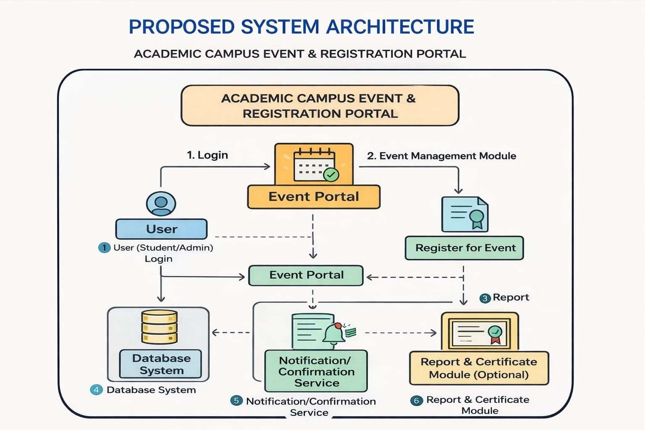
1
2
3
4
5
6
7
8
9

Slide 7

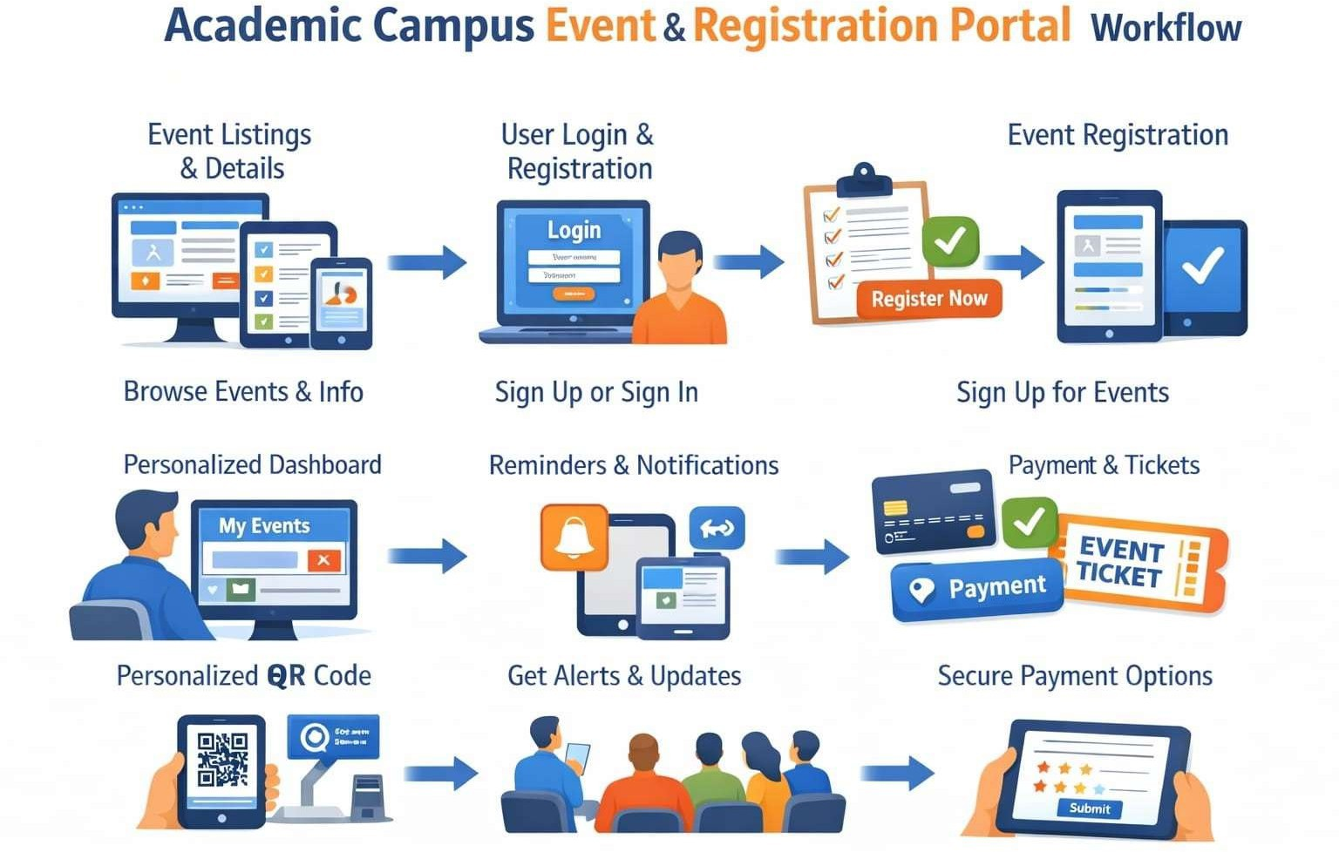
1
2
3
4
5
6
7
8
9

Slide 8






-
HTML5
CSS3
Java script
:
1
2
3
-
Node.js (v18e),
Express.js framework
4
5
6
-
MySQL 8.0
Node.js
7
-
vs code
intellij IDEA
8
9
-
windowsIMac
web Browser
:

Slide 9

























1
2
3
Handles full student lifecycle: registration form (name, email, student ID, dept, phone), bcrypt password hashing, session-based loginIlogout, and account validation with duplicate email checks.
4
5
Admins create events with title, description, date, location, category, max seats, and image (URL or file upload). Students browse events with live category filters and real-time seat availability
6
7
8
Handles event registration logic: duplicate prevention (UNIQUE constraint on emaileevent_id), seat capacity enforcement, student dashboard with registered events, and one-click cancellation
9
Secured admin portal with separate login, live dashboard stats (total eventsIusersIregistrations), event CRUD operations, full registrations table, student roster, and individual record deletion.

Slide 10




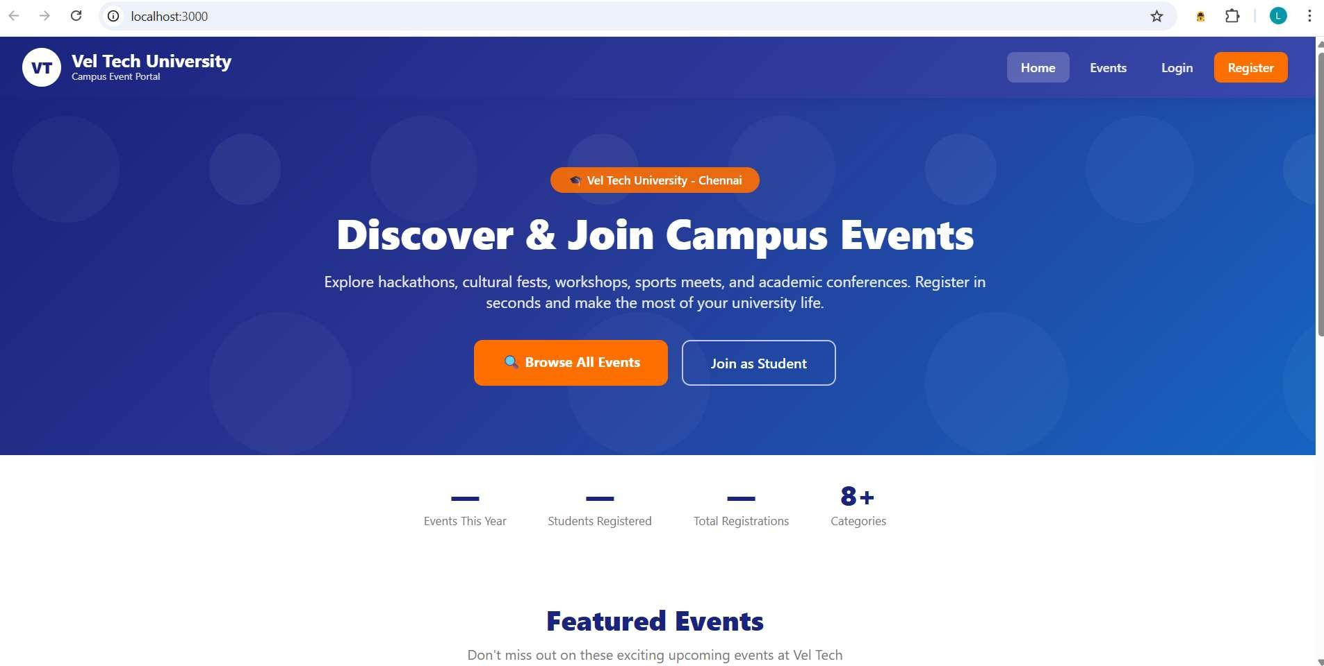

H O M E
A G E :
1
2
3
4
5
6
7
9

Slide 11

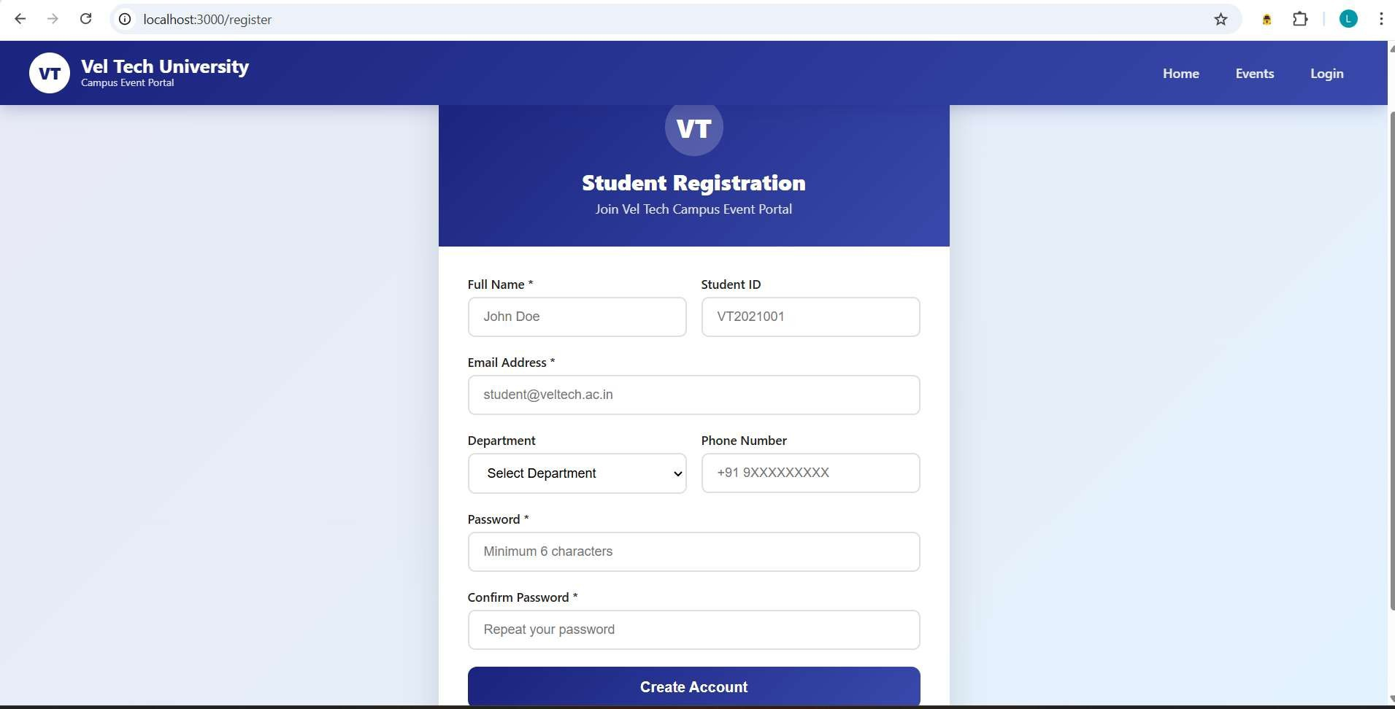

R E G IS T R A T IO N
A G E :
1
2
3
4
5
6
7
9

Slide 12
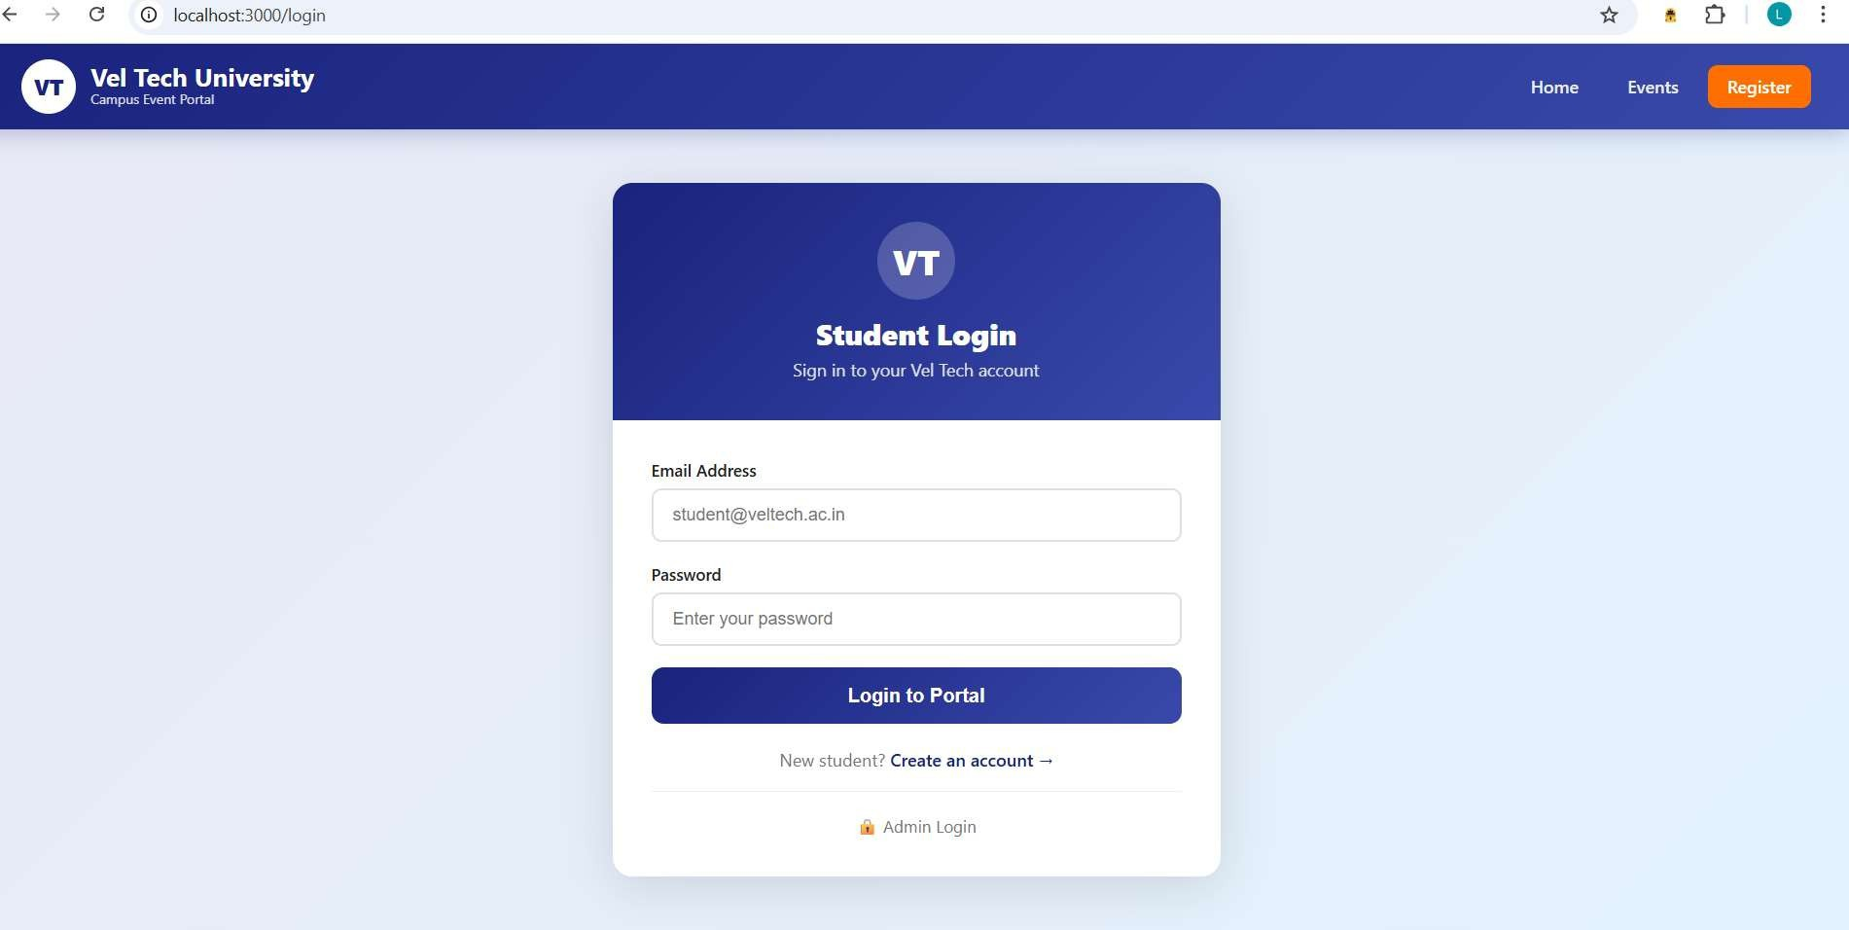
L O G IN
A G E :
1
2
3
4
5
6
7
9

Slide 13
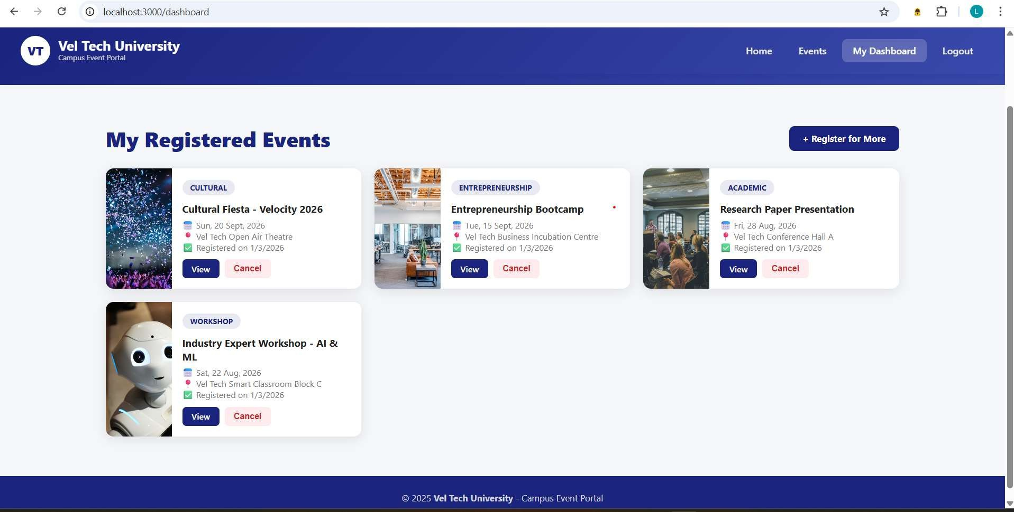

O U T U T A G E :
1
2
3
4
5
6
7
9

Slide 14








1
2
1. Easy online event registration for students.
3
2. Reduces paperwork and manual work.
Centralized management of all campus events.
4
Secure login system for students and admin.
5
5. Quick access to participant and event reports.
6
7
Requires internet connection to access.
8
Limited to basic roles (Admin and Student).
9
3. No built-in payment system (if not integrated).
erformance may slow with heavy traffic.
Requires regular maintenance and updates.

Slide 15



